Slide 1
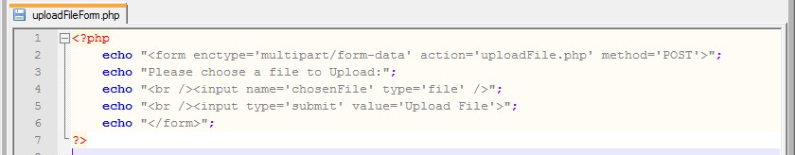
Using PHP to Upload a File to the Server – Part 1
Your public_html is a space on the server. We want to create an application where a file can be uploaded to the server space. Exactly like how people submit their CVs.
The first step is to create a form that contains a Text Box and a Submit button
Once this has been created the we will need to write a PHP Script that will transfer the file to the server
Here is the PHP Script that generates the HTML needed to create the form we need:

Slide 2
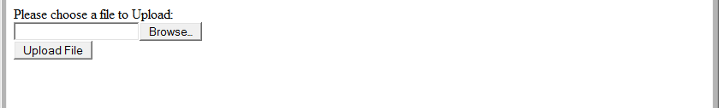
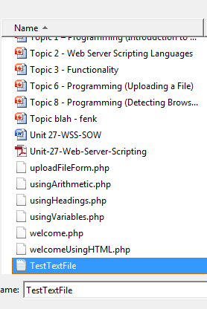
Using PHP to Upload a File to the Server – Part 2
The PHP Script on the previous slide should give you the following screen:
When you click on the
Browse... Button then
you will get a File
Dialogue Box where
you can choose the File:

Slide 3
Using PHP to Upload a File to the Server – Part 3
Once you have selected your File and clicked on Open then your screen will display an input box along with a browse button.
The next step is to create the PHP Script that will Upload the File to the Server
We specified that our PHP Script would be called uploadFile.php In the
echo "<form enctype='multipart/form-data' action='uploadFile.php' method='POST'>"; line within the uploadFileForm.php Script

Slide 4
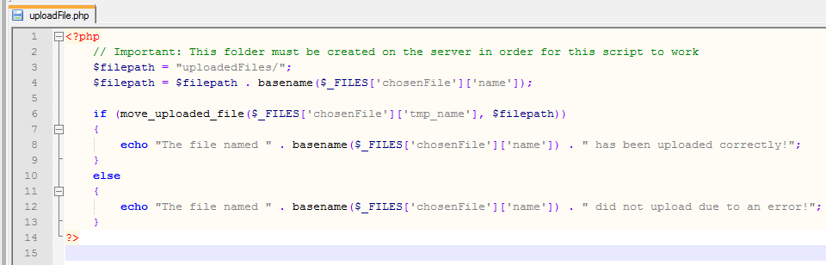
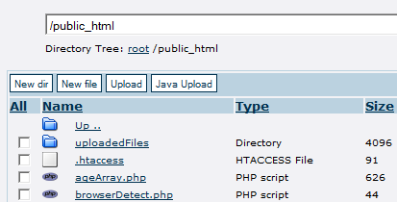
Using PHP to Upload a File to the Server – Part 4
Now we need to create the PHP Script for uploadFile.php:
Important Note: Make sure that you
create a folder called uploadedFiles
in order for the above Script to work!

Slide 5
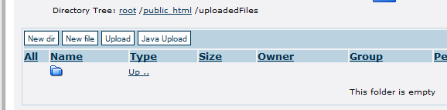
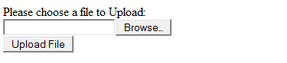
Using PHP to Upload a File to the Server – Part 5
Now that we have both the PHP Script for the Form and the Button we can now begin to test it to make sure it works
Step One – Make sure the uploadedFiles folder is empty:
Step Two – Run the uploadFileForm.php Script in your Browser:

Slide 6
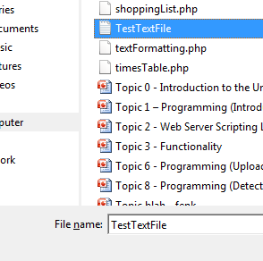
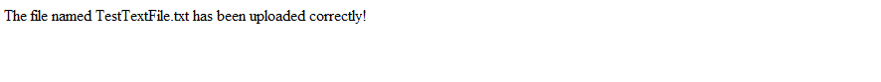
Using PHP to Upload a File to the Server – Part 6
Step Three – Click on Browse... And find the file that you
want to upload
and click on
Open:
Step Four – Click on Upload File:
You should get the following screen:

Slide 7
Using PHP to Upload a File to the Server – Part 7
Step Five – Check the uploadedFiles Folder on the Server to make sure the file has uploaded correctly.

Slide 8
Exercises
1 – Uploading a File to the Server
1a) Create PHP Scripts that will allow you to upload a File and store it on your Server
1b) Test your PHP Scripts
2 – Find out the meaning and functionality of the following in PHP:
2a) basename($_FILES['chosenFile']['name'])
2b) move_uploaded_file($_FILES['chosenFile']['tmp_name'], $filepath)

